Slide 1
KnowItAll Web App
——Iteration 2 Report
Daniel Makover
Kun Mo
Gunnar Nichols
Heli Kolambekar
Haoyi Zhu
Yuwei Wu
Weiye Xu

Slide 2
Iteration 2 Plans vs Results
Users
Players will be able to login as distinct users
Will support password reset and email verification
Game session restoring (time permitting)
Additional Lifelines
Add 50/50 lifeline
Add additional time for question lifeline
Testing
Establish Testing Scripts
Categories
Before initiating a game the player will have a chance to select a category
Each category has a distinct leaderboard
Profile Page
Players will be able to see their top scores and other user statistics
Players will be able to manage user profiles
Code Refactoring
Current code will be reorganized and streamlined

Slide 3
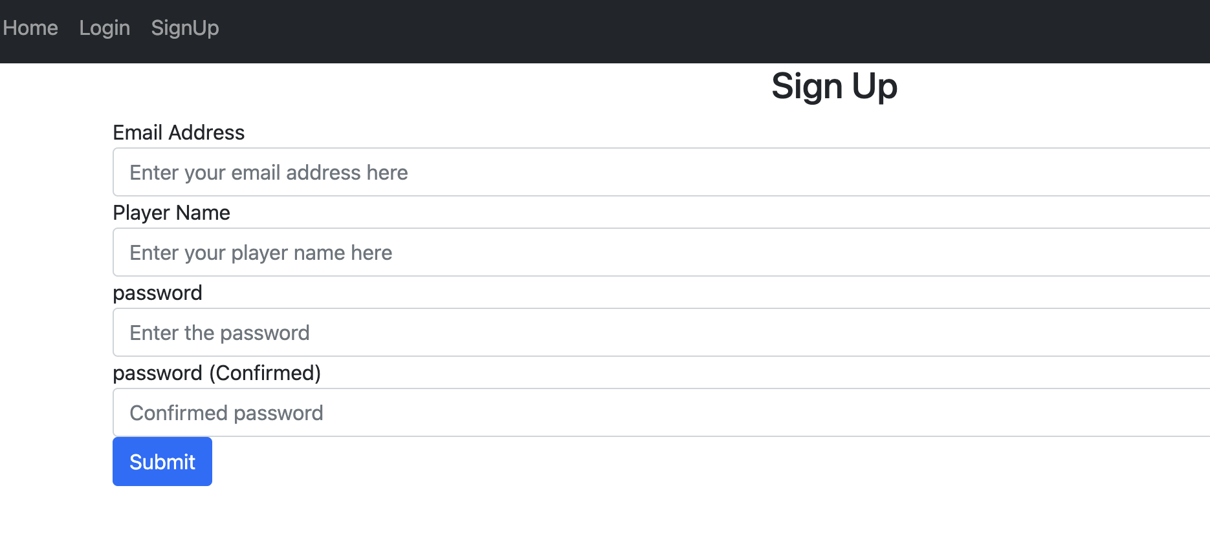
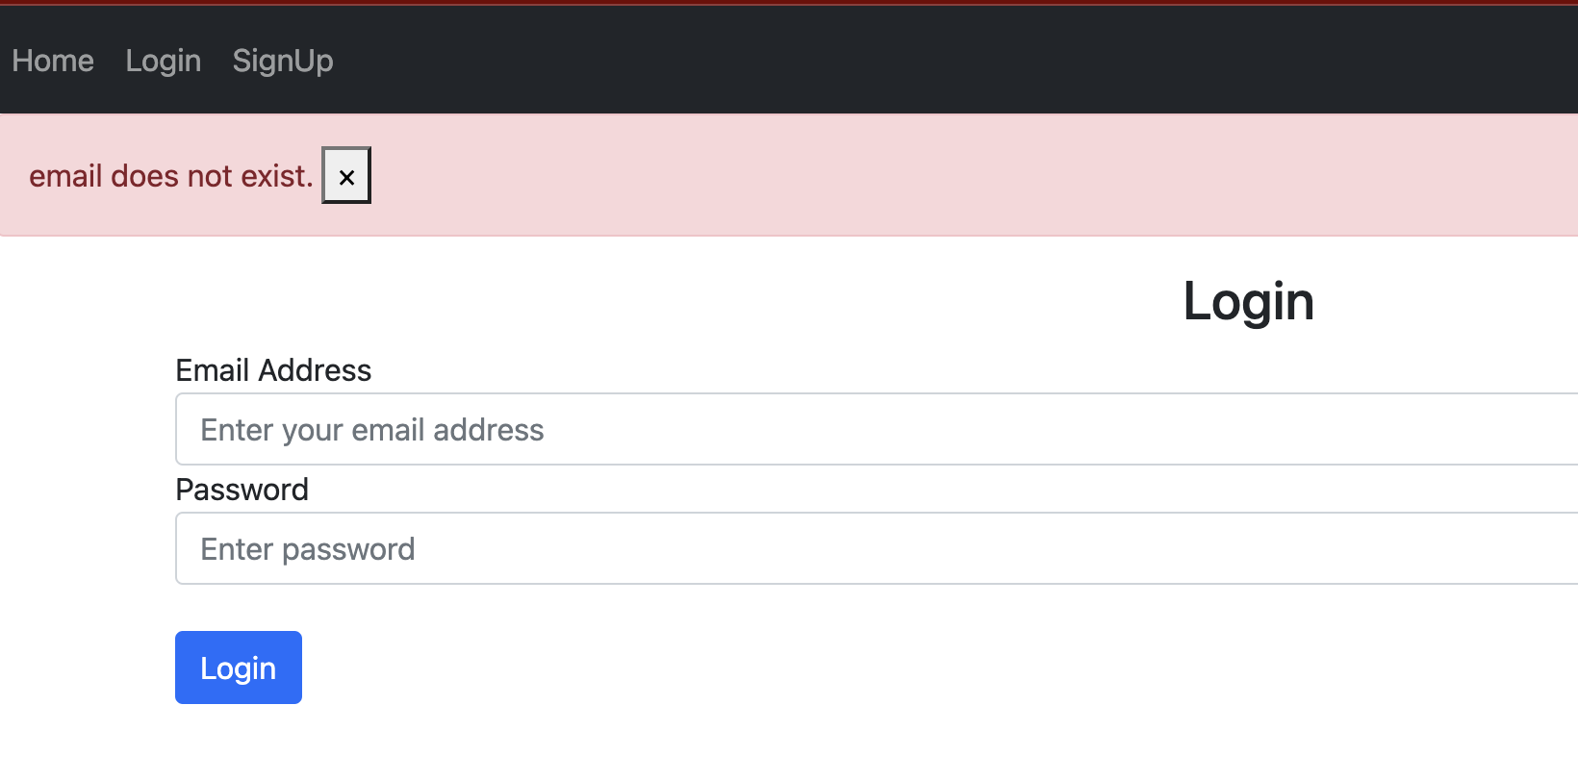
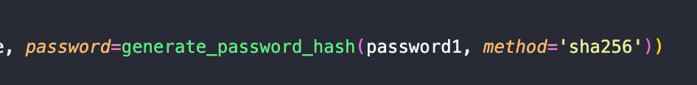
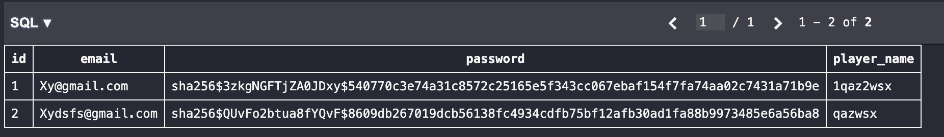
New feature:
User Login Functionality
Sign up page:
Login page:
Security:

Slide 4
Demo

Slide 5
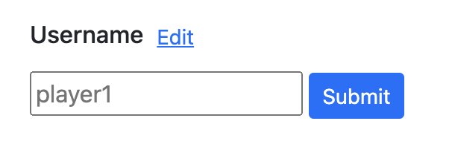
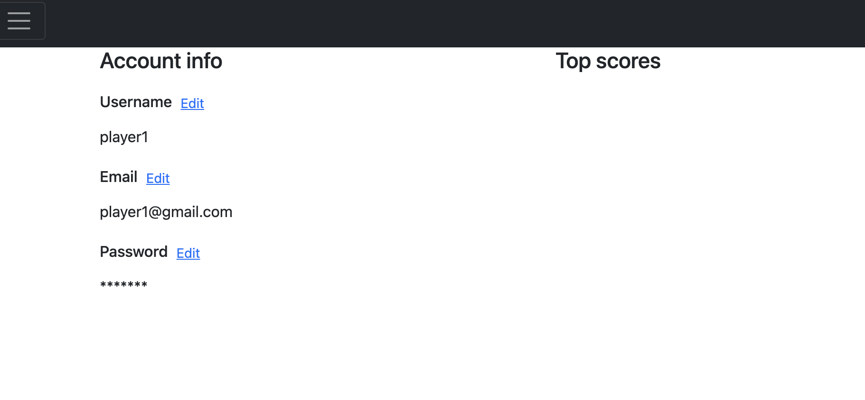
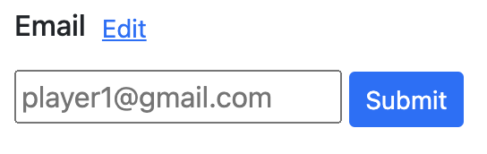
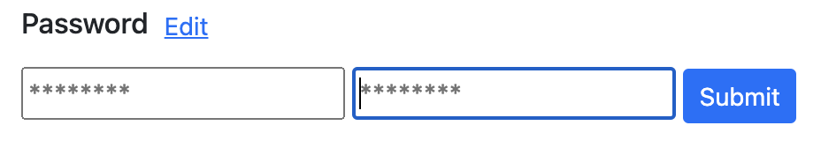
New feature:
Player Profile page
Edit button:
Page layout:

Slide 6
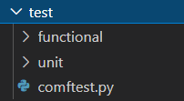
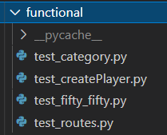

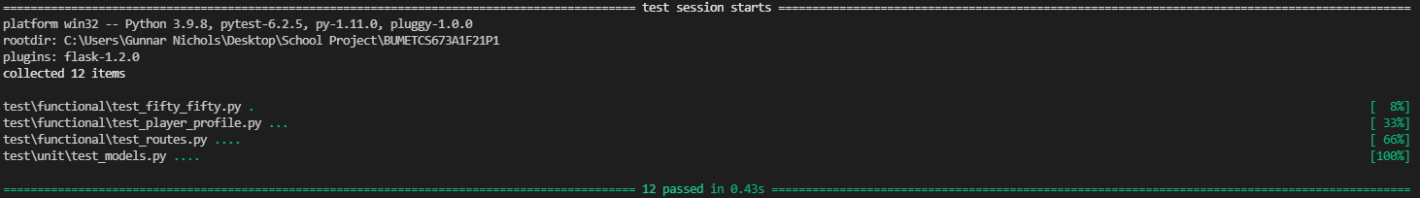
Testing Setup with Pytest-flask
Folder Structure:
Functional Tests:
Unit Tests:
Testing Session:

Slide 7
Testing Demo

Slide 8
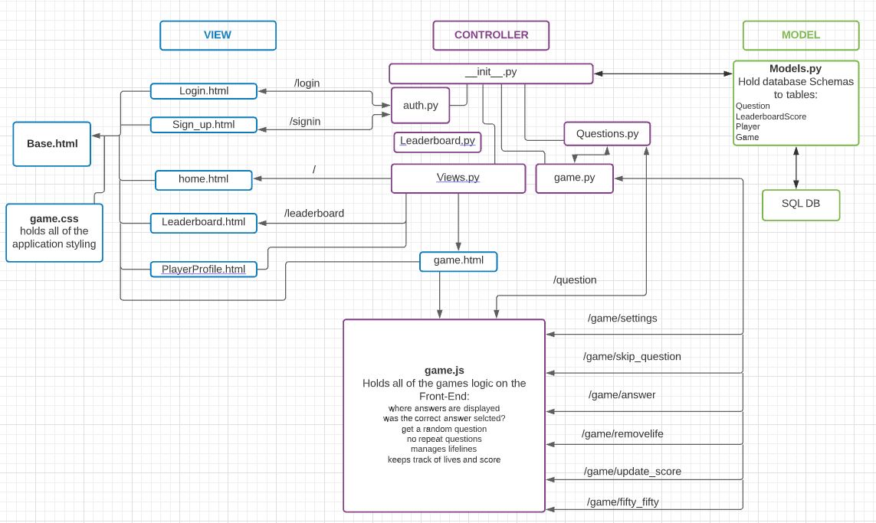
Logic Refactor

Slide 9
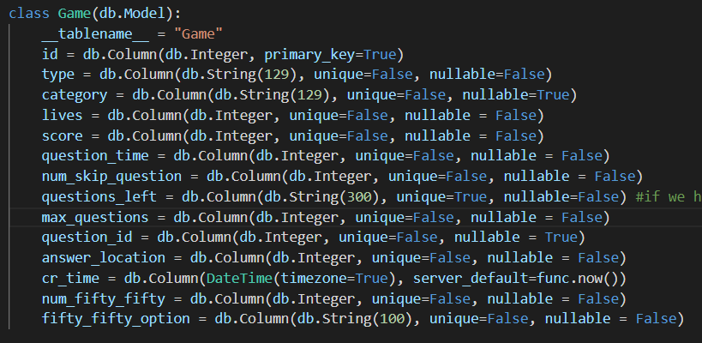


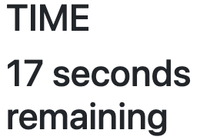
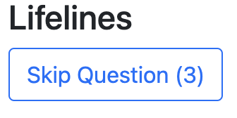
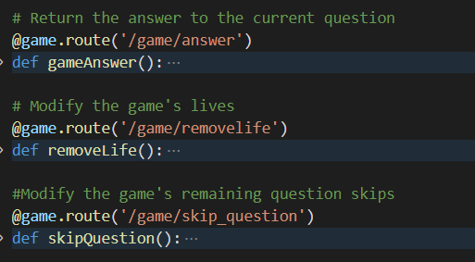
Variables Refactor
Solutions to previous concerns:
Frontend
Backend
Player-end:
game.js
Server-end:
models.py
Updates via the current value of the backend variable
Holds variables only changed by backend functions

Slide 10
Benefits of Refactor
Improved code readability and maintainability
Removes bad smells like- long method and data clumps
Improves quality of code- length, duplication, coupling, cohesion
Leads to creation of reusable code modules in a large project

Slide 11
Iteration 3 Plan
Users
Will support password reset and email verification
Game session restoring (time permitting)
Superuser crud capabilities (time permitting)
Testing
Vastly expand automatic testing capabilities
Gameplay
Expand game session to handle many users
Categories
Each category has a distinct leaderboard
User Feedback
Will fetch feedback/ratings from user
Hosting the app on a server
Will use a remote online server to dynamically allocate resources to host the app

